Slide 1
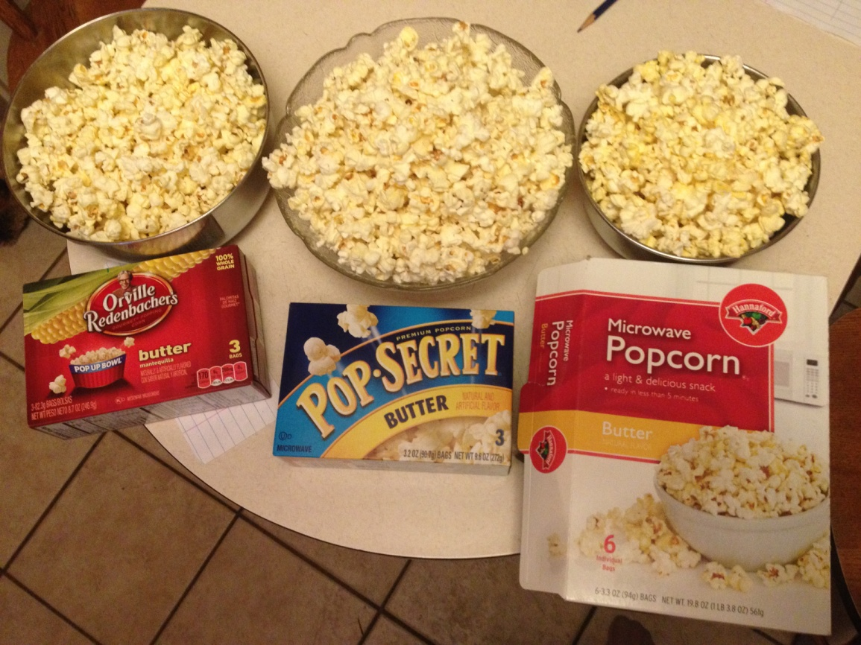
Decimals and Percents with Popcorn
By Katrina Apelles

Slide 2
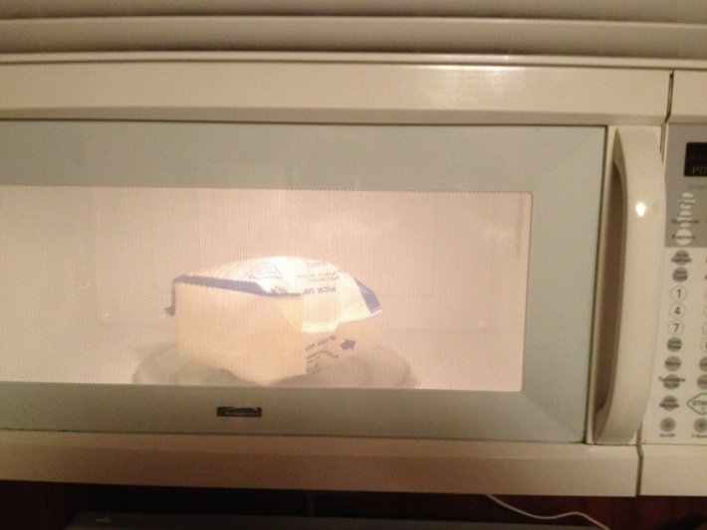
Hannaford Brand Popcorn
Popped
Not popped

Slide 3
Orville Redenbacher's
Popped
Not popped

Slide 4
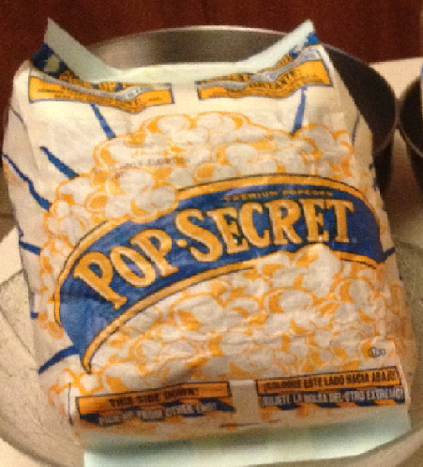
Pop Secret
Popped
Not popped

Slide 5
Compare results
 | My results | Class results
Hannaford (popped) | 92.15%
(not popped) | 7.85%
Orville Redenbacher’s (popped) | 88.66%
(not popped) | 11.34%
Pop Secret (popped) | 94.74%
(not popped) | 5.26%
Calculate percent error

Slide 6
How many pieces are popped and not popped in a box?
Hannaford Brand (use my results to decide this)

Slide 7
Continued…
Orville Redenbacher’s(use my results to decide this)

Slide 8
Continued…
Pop Secret (use my results to decide this)

Slide 9
Best price
 | Hannaford Brand | Orville Redenbacher’s | Pop Secret
Price | $2.88 | $2.69 | $2.79
# of bags | 6 | 3 | 3
Which type of popcorn is the best price?
Hannaford Brand popcorn is the best price.

Slide 10
Extra questions:
Which popcorn has the best, buttery flavor?
Which popcorn has the most popped corn in the bag?

